Slide 1
CREDIT RISK PREDICTION SYSTEM
Applying Machine Learning Life Cycle to classify Loan applicants as High-risk or Low-risk

Slide 2
Problem Statement Why the organisation needs a predictive credit risk model
1
2
3
Current situation
A mid-sized financial services company still relies on a fixed rule-based credit approval process.
The gap
Rule-based scoring cannot capture nonlinear relationships in applicant data or adapt to new trends.
The cost
This causes false approvals (financial loss) and false rejections (lost business and poor customer experience).
Objective
Is to build a supervised machine learning classification system that follows a full ML Life Cycle (acquisition, preprocessing, PCA, modelling, evaluation and tuning) to predict whether a loan applicant is high-risk or low-risk and translate the results into business recommendations.

Slide 3
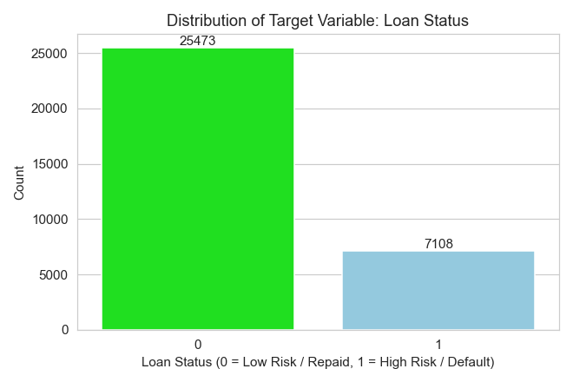
Dataset overview
32 581
Rows: Loan Applicants
12
Original columns
78% / 22%
Low-risk or High-risk split
Key features
Feature | Description
person_age / person_income | Applicant demographics.
person_home_ownership / person_emp_length | Housing status and years employed.
loan_intent / loan_grade | Purpose and internal risk grade (A-G).
loan_amnt / loan_int_rate | Loan size and interest rate.
loan_percent_income | Loan amount as % of income.
cb_person_default_on_file / cred_hist_length | Prior default flag and credit history length.
loan_status (target) | 0 = Low risk or repaid 1 = High risk or default

Slide 4
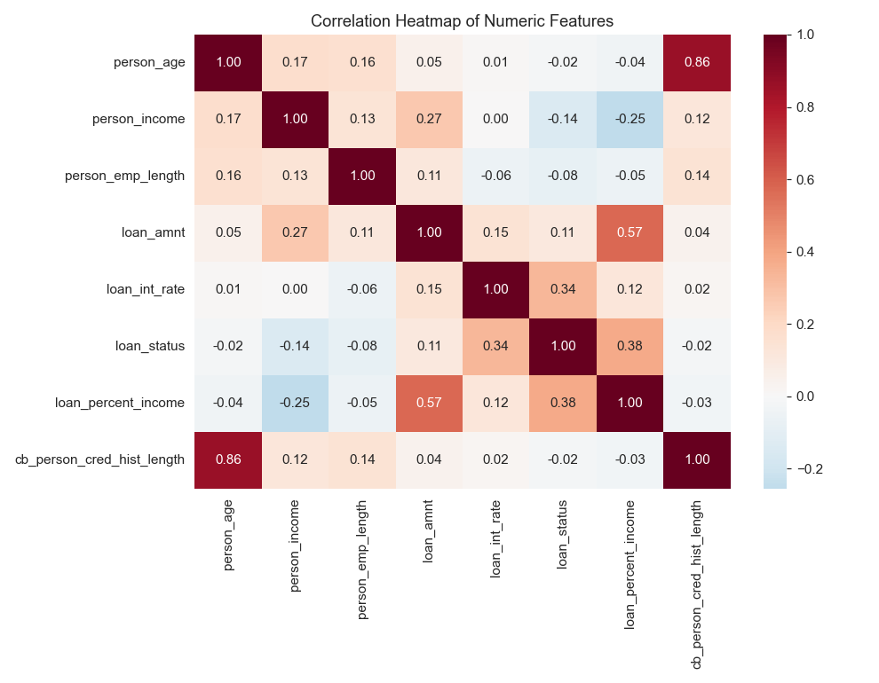
Data issues identified
Missing values
loan_int_rate: 3 116 missing (9.6%).
Person_emp_length: 895 missing (2.7%).
Duplicate rows
165 exact duplicates records found in the row dataset.
Impossible outliers
person_age up to 144 years and person_emp_length up to 123 years of employment.
Extreme but valid outliers
person_income up to 6 000 000 large spreads in loan_amt and loan_int_rate.
Class imbalance
78% low risk vs 22% high risk applicants {accuracy alone is a misleading metric}.
Skewed distributions
person_income, loan_amt and loan_percent_income are strongly right skewed.

Slide 5
Preprocessing summary Cleaning, encoding, scaling and splitting the data
1. Missing values | person_emp_length imputed with the median (robust to skew). loan_int_rate imputed with the median rate per loan_grade since rate is tied to grade.
2. Duplicates | 32 581 – 165 duplicates rows = 32 416 rows remaining
3. Outliers | Impossible values removed (age > 100 years and employment length > 60 years). Remaining outliers capped using the IQR method rather than deleted to keep genuine high earners in the data.
4. Encoding | loan_grade mapped 0 – 6 and cb_person_default_on_file mapped Y/N to 1/0. person_home_ownership and loan_intent one hot encoded.
5. Feature scaling | StandardScaler applied to numeric features because algorithms such as KNN and logistic regression would let large magnitude feature like income dominate.
6. Train / test split | 80/20 split = 25 927 training rows and 6 482 testing rows preserving the class ratio.

Slide 6
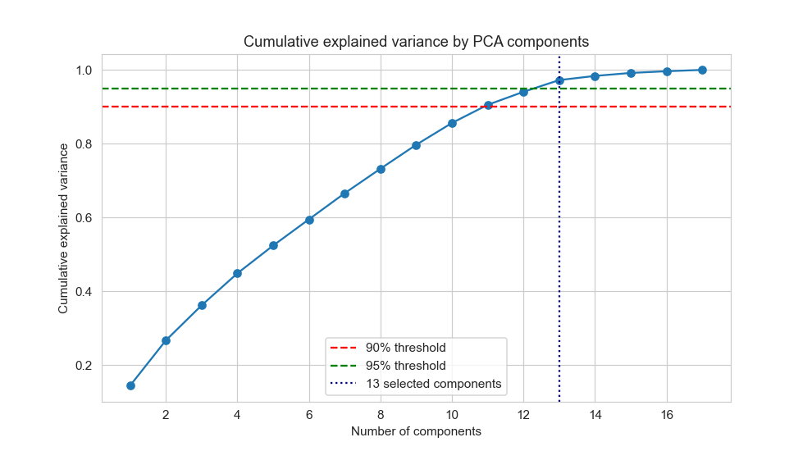
PCA explanation and variance plot
PCA compresses correlated features into fewer uncorrelated components reducing dimensionality while preserving most of the informative variance.
Number of components needed for 90% variance:
11
Number of components needed for 95% variance:
13
13 components (95% threshold) were selected keeping most information while cutting model input size and reducing overfitting risk from redundant features.

Slide 7
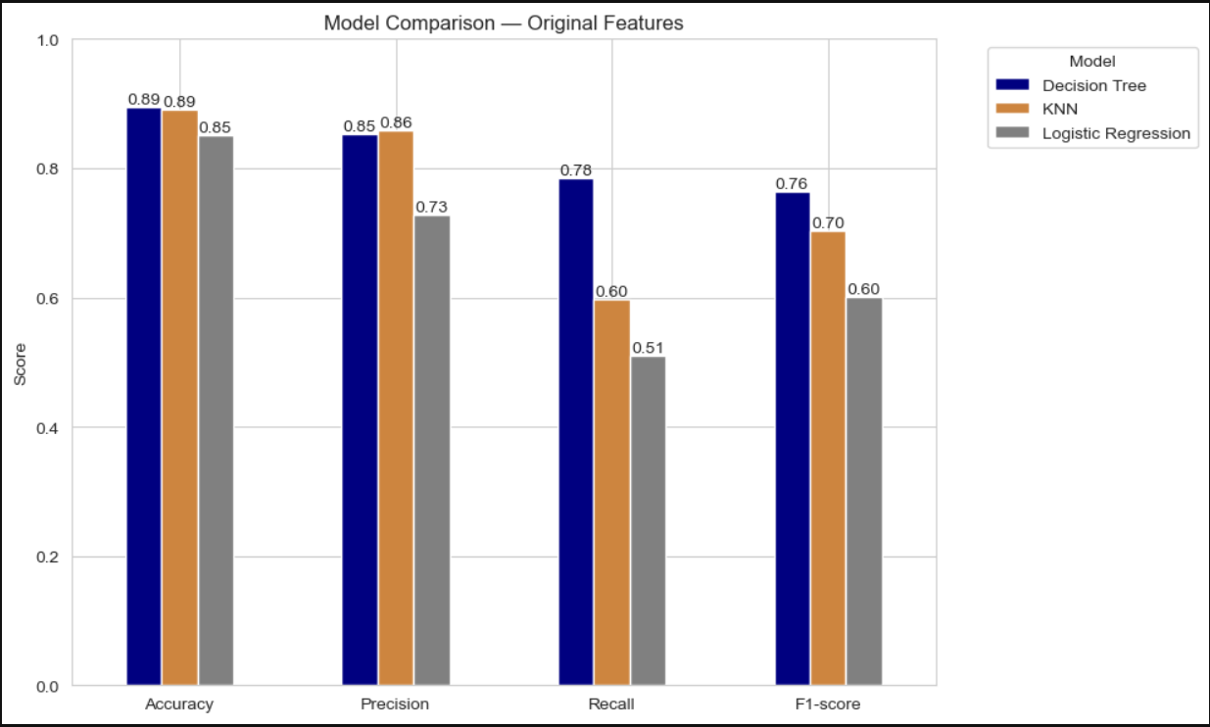
Model comparison – Before PCA
Three classifiers trained on the 17 scaled encoded features
Model | Accuracy | Precision | Recall | F1-score
Logistic regression | 0.851 | 0.728 | 0.511 | 0.600
K-NN | 0.890 | 0.859 | 0.597 | 0.704
Decision Tree | 0.894 | 0.852 | 0.785 | 0.764
Decision tree leads on Recall and F1-score and this is important since missing a actual high-risk applicant (false negative) is costlier error for a lender.

Slide 8
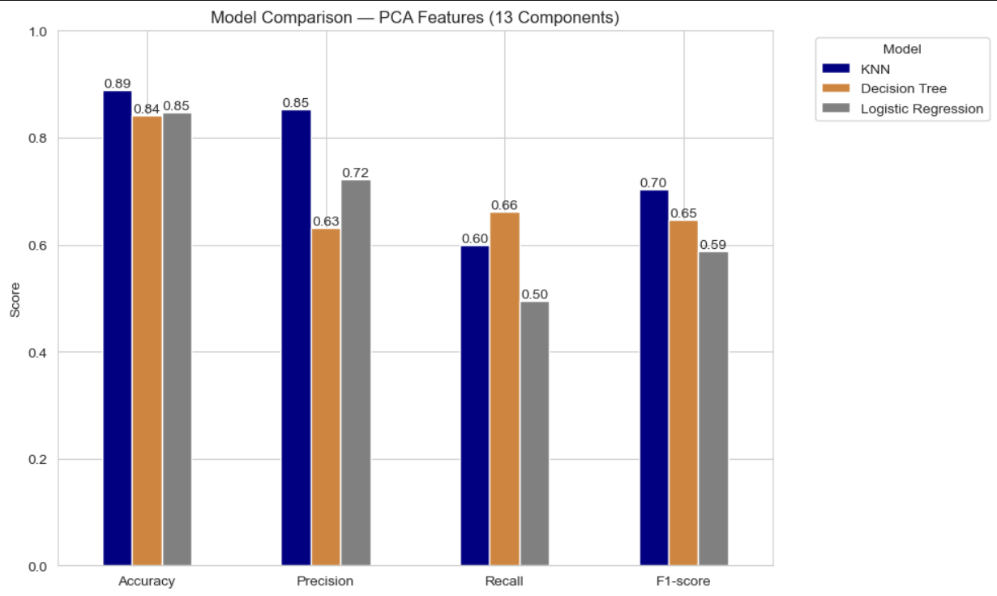
Model comparison – After PCA
Same three classifiers retrained on the PCA transformed data.
Model | Accuracy | Precision | Recall | F1-score
Logistic regression | 0.848 | 0.723 | 0.495 | 0.588
K-NN | 0.890 | 0.852 | 0.599 | 0.703
Decision Tree | 0.841 | 0.631 | 0.661 | 0.646
PCA gave almost the same results for Logistic Regression and KNN but hurt the Decision tree which loses meaning once features are rotated into components.

Slide 9
Hyperparameter tuning

